Slide 1
Boxwood Blight
Identifying a Devastating Pathogen of Boxwood
This workshop was created by the staff of the
Plant Disease Diagnostic Clinic with
financial support made possible through a NYS Community IPM grant
Notes:
This training module is on Boxwood Blight and its purpose is to help you in Identifying a Devastating Pathogen of Boxwood
(next slide)

Slide 2
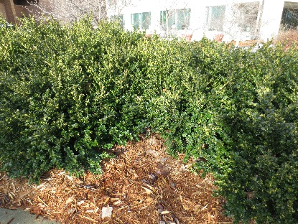
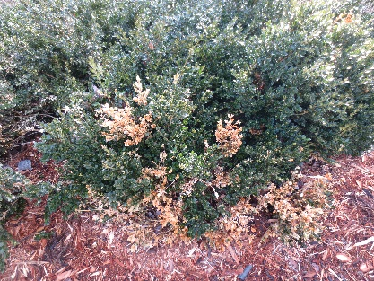
What is Boxwood Blight?
Boxwood blight is a disease caused by the fungus Calonectria pseudonaviculata, but we are most familiar with the asexual/imperfect/conidial state, Cylindrocladium pseudonaviculatum (syn = C. buxicola).
The fungus infects boxwood, and when active, can cause leaf spots, twig lesions, shedding of foliage and death of the infected plant.
The fungus produces copious spores of the conidial state of the fungus on infected tissue. When diagnosing boxwood blight, we look for the conidial state.
Notes:
What is Boxwood Blight?
Boxwood blight is a disease caused by the fungus Calonectria pseudonaviculata, but we are most familiar with the asexual/imperfect/conidial state, Cylindrocladium pseudonaviculatum (syn = C. buxicola).
The fungus infects boxwood, and when active, can cause leaf spots, twig lesions, shedding of foliage and death of the infected plant.
The fungus produces copious spores of the conidial state of the fungus on infected tissue. When diagnosing boxwood blight, we look for the conidial state.
(By the time the first symptoms are observed on an individual plant, asymptomatic tissues may already be infected.)
(next slide)

Slide 3
Boxwood Blight
A second species, Calonectria henricotiae, is known in some European countries, but that species is not easily differentiated from C. pseudonaviculata using fungal morphology. Genetic testing is required to differentiate these two species.
As of this writing, C. henricotiae has not been confirmed in the U.S., but C. pseudonaviculata has been detected at least once in at least 16 continental U.S. states including several states in the northeastern U.S. (CT, DE, MA, MD, NH, NJ, NY, PA, RI, VA and WV).
The pathogen has also been detected in some Canadian provinces.
Notes:
Boxwood Blight
A second species, Calonectria henricotiae, is known in some European countries, but that species is not easily differentiated from C. pseudonaviculata using fungal morphology. Genetic testing is required to differentiate these two species.
As of this writing, C. henricotiae has not been confirmed in the U.S., but C. pseudonaviculata has been detected at least once in at least 16 continental U.S. states including several states in the northeastern U.S. (CT, DE, MA, MD, NH, NJ, NY, PA, RI, VA and WV).
The pathogen has also been detected in some Canadian provinces.
(next slide)

Slide 4
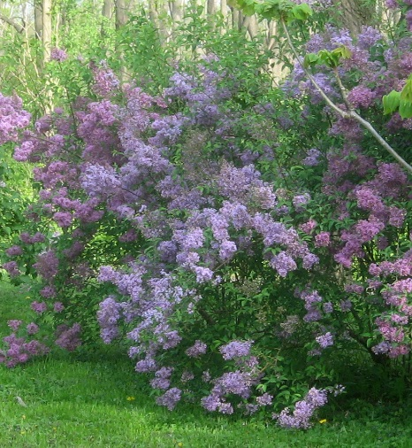
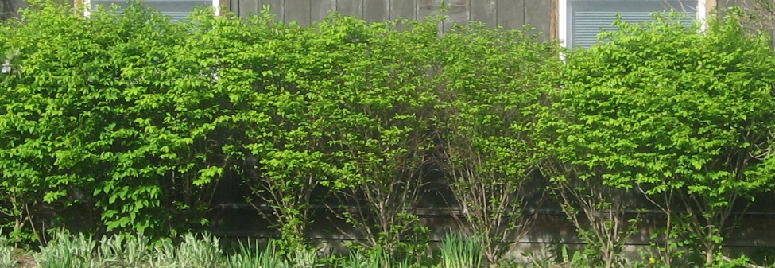
Why do we care about boxwood?
Boxwood plants fit a niche that few other woody ornamentals can fill.
They are compact, evergreen, and can be sheared into various shapes.
Japanese holly is one of the few other evergreen shrubs of this size that may be readily managed as smaller hedges, but this gives us only one replacement option…
Other plants that may be used to replace boxwoods in the landscape…
…may not be evergreen
…may not be as readily shaped
…may be invasive
…may be limited to fewer planting zones
Notes:
Why do we care about boxwood?
(These plants are loved by some and hated by others)
Boxwood plants fit a niche that few other woody ornamentals can fill.
(advance)
They are compact, evergreen, and can be sheared into various shapes.
(advance)
Japanese holly is one of the few other evergreen shrubs of this size that may be readily managed as smaller hedges, but this gives us only one replacement option…
(advance)
Other plants that may be used to replace boxwoods in the landscape…
(advance)
…may not be evergreen
…may not be as readily shaped
…may be invasive
…may be limited to fewer planting zones
Persian lilac (top right) is deciduous and not as readily shaped.
Burning bush euonymus (bottom photo) is deciduous and invasive
(next slide)

Slide 5
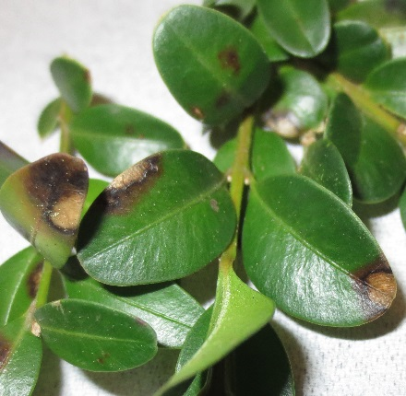
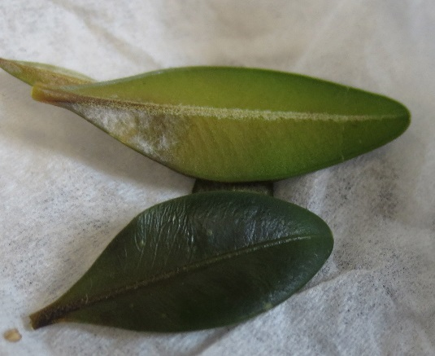
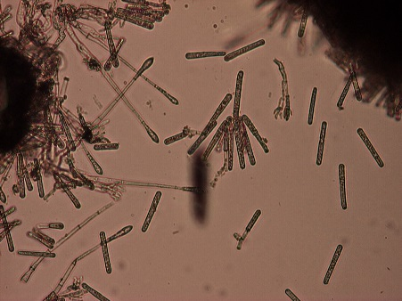
Identification is the focus of this module.
With the spread of boxwood blight out of nurseries and into landscapes, and in some cases into very large landscape plantings, it is important to identify the pathogen quickly--so infected plants may be removed and asymptomatic plants treated.
The fungus can begin to produce infectious spores in a matter of days after symptoms first develop.
Spores are easily spread to other nearby boxwood so quick identification of the pathogen is essential in limiting the spread of the fungus.
Notes:
Identification is the focus of this module.
With the spread of boxwood blight out of nurseries and into landscapes, and in some cases into very large landscape plantings, it is important to identify the pathogen quickly so infected plants may be removed and asymptomatic plants treated.
(advance)
The fungus can begin to produce infectious spores in a matter of days after symptoms first develop
(advance)
Spores are easily spread to other nearby boxwood so quick identification of the pathogen is essential in limiting the spread of the fungus.
(next slide)

Slide 6
Other pathogens can damage boxwood, cause dieback and even kill entire plants, but the Boxwood Blight pathogen does this very quickly.
Once you are familiar with what to look for, it can be easy to recognize the fungus when it is present on infected tissue.
…but recognizing when symptoms are not Boxwood Blight is equally important to limit the destruction of plants that may have less damaging issues!
When done with this module, if you would like to learn more about the pathogen, the following resource list is included in your handouts.
Notes:
Other pathogens can damage boxwood, cause dieback and even kill entire plants, but the Boxwood Blight pathogen does this very quickly.
Once you are familiar with what to look for, it can be easy to recognize the fungus when it is present on infected tissue
(advance)
…but recognizing when symptoms are not Boxwood Blight is equally important to limit the destruction of plants that may have less damaging issues!
(advance)
When done with this module, if you would like to learn more about the pathogen, the following resource list is included in your handouts.
(next slide)

Slide 7
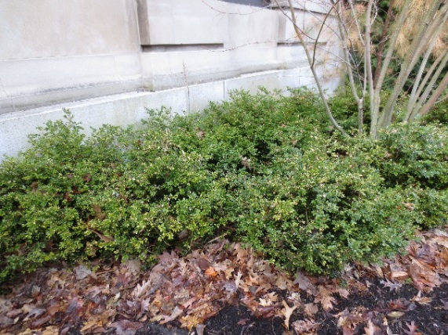
Additional Resources!
We recommend the “Photographic Guide of Boxwood Pests & Diseases on Long Island” available at: http://ccesuffolk.org/resources/photographic-guide-of-boxwood-pests-diseases-on-long-island.
Cornell Cooperative Extension – Suffolk Co. http://ccesuffolk.org/nursery-and-landscape/
North Carolina resources on box blight: http://go.ncsu.edu/boxwood_blight_links
Connecticut resources on box blight: https://portal.ct.gov/CAES/PDIO/Boxwood-Blight/Boxwood-Blight
USDA Boxwood blight fact sheet: https://nifa.usda.gov/sites/default/files/resource/Boxwood_Fact_Sheet_Rev1.pdf
NPDN Boxwood blight slide set: http://slideplayer.com/slide/6046607/
Notes:
Although produced by Cornell Cooperative Extension of Suffolk Co. for a Long Island audience, the Photographic Guide of Boxwood Pests & Diseases on Long Island really covers many of the common issues observed on boxwood plants across the entire Northeastern U.S., including boxwood blight, other disease issues, insect pests, abiotic injury, and much more.
This resource list is included in the handouts
These resources have many photos of infected plants in the landscape---but here we will be focusing on confirming the diagnosis of the fungus using microscopy.
(next slide)

Slide 8
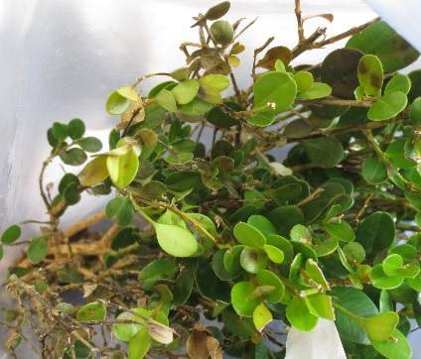
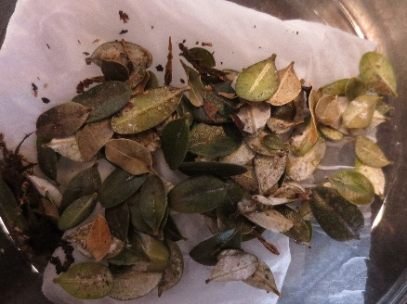
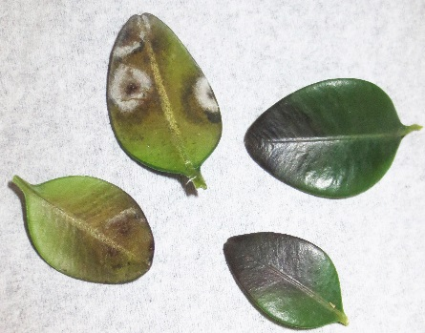
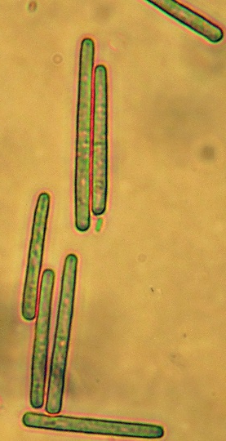
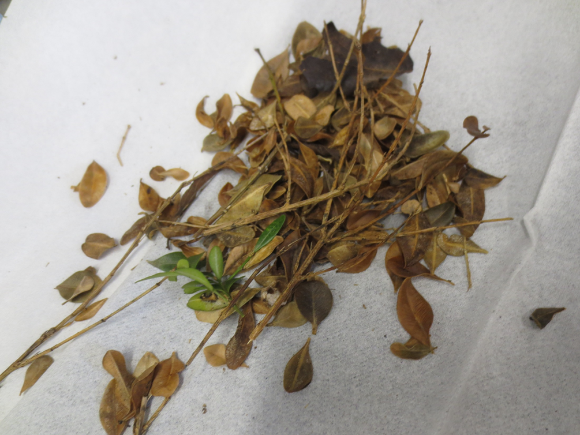
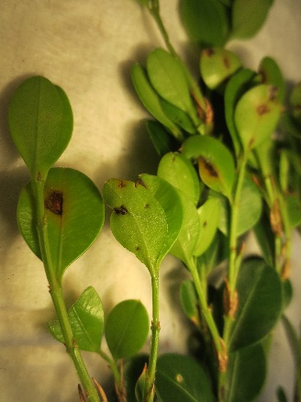
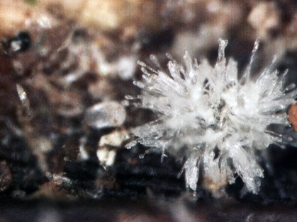
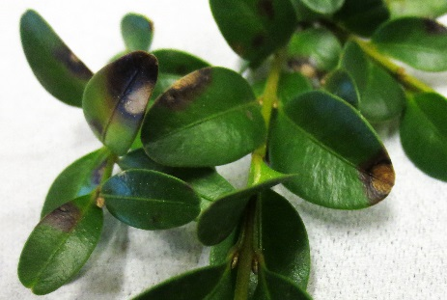
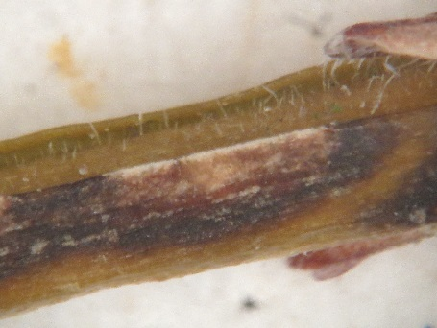
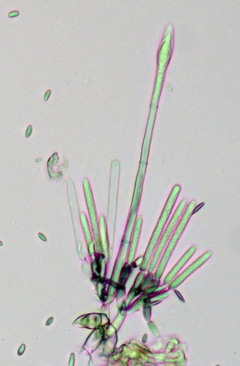
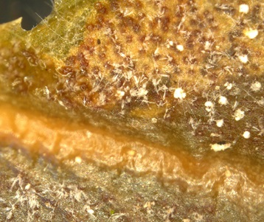
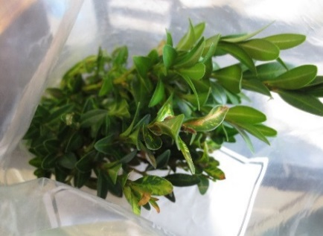
What does Boxwood Blight look like?
Notes:
What does Boxwood Blight look like?
At any stage you may see any of these features, but only one of these photos does not show boxwood blight
(advance)
(Each lab should have a handout that includes the best of these photos for use as a reference when examining suspect BB samples)
(next slide)

Slide 9
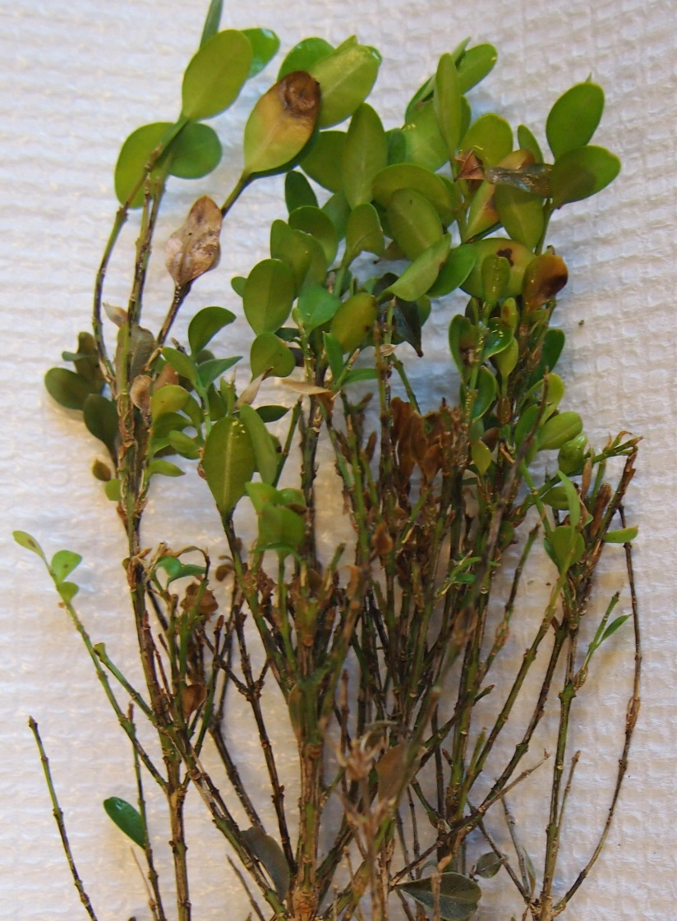
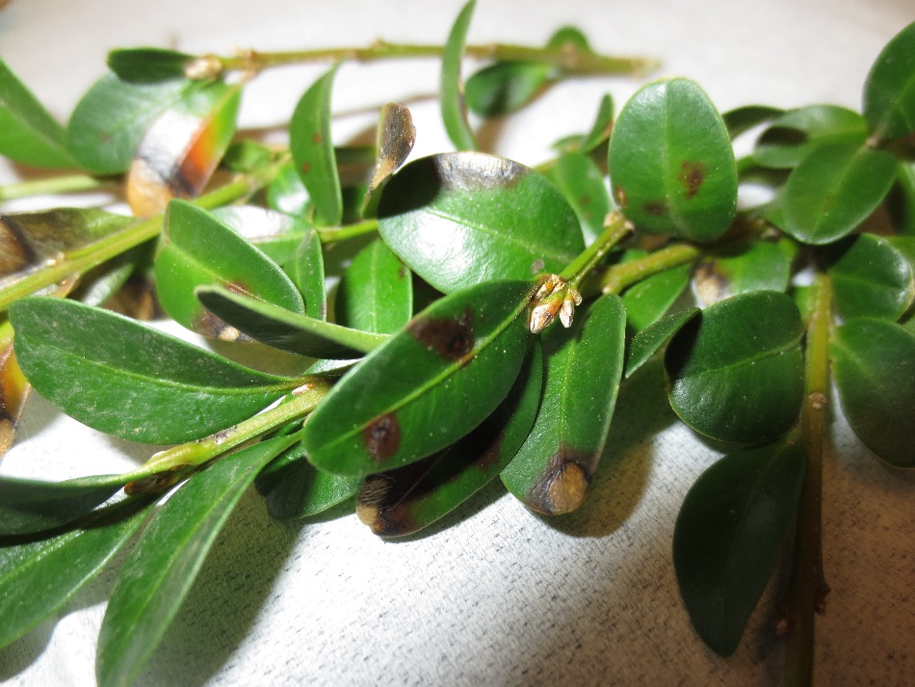
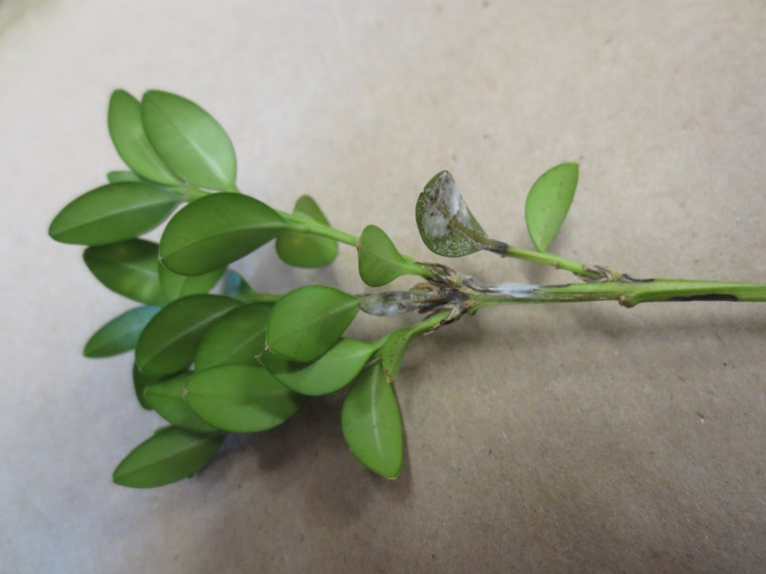
It may look like…
Notes:
If you are sent a sample, it may look like this
(advance)
Or this
(advance)
or just this
(next slide)

Slide 10
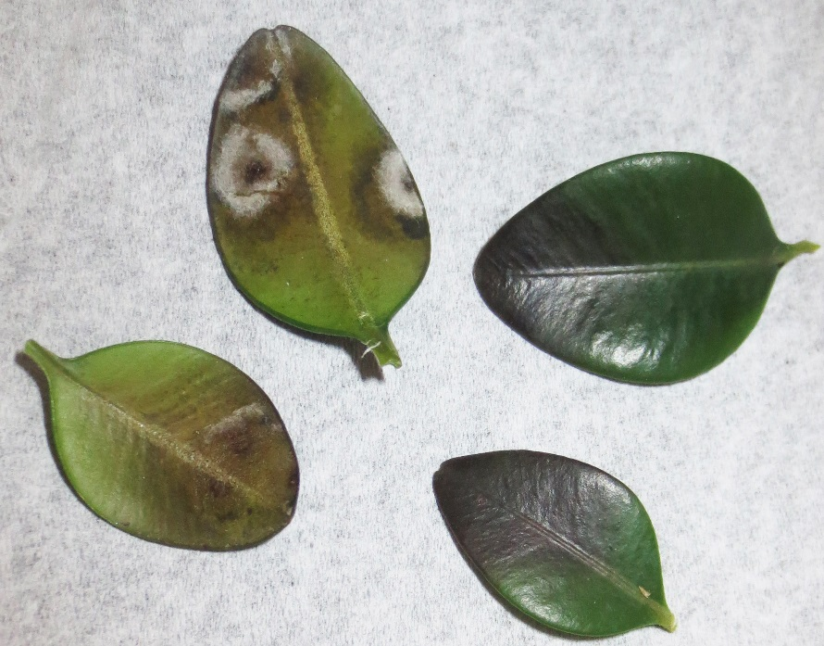
So what do we look for?
We will look for different things depending on our role(s) in managing this disease.
A nursery grower or state regulatory official may look for the first sign of disease-which may typically be one or more dark foliar lesions.
Notes:
So what do we look for?
We will look for different things depending on our role(s) in managing this disease.
(advance)
A nursery grower or state regulatory official may look for the first sign of disease-which may typically be one or more dark foliar lesions.
(next slide)

Slide 11
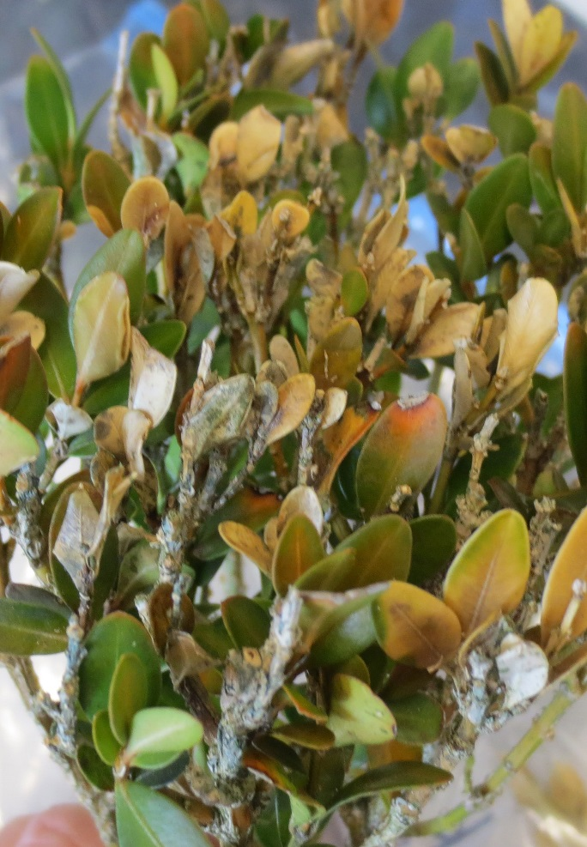
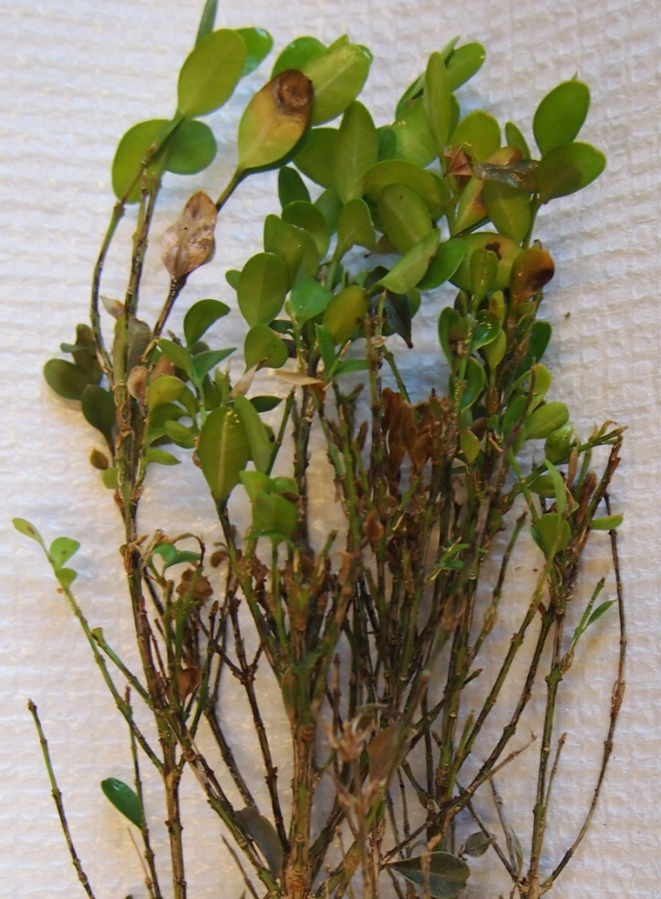
A homeowner or landscape professional may look for overall symptoms such as sudden decline, off color foliage and/or shedding of foliage.
Notes:
A homeowner or landscape professional may look for overall symptoms such as sudden decline, off color foliage and/or shedding of foliage. (next slide)

Slide 12
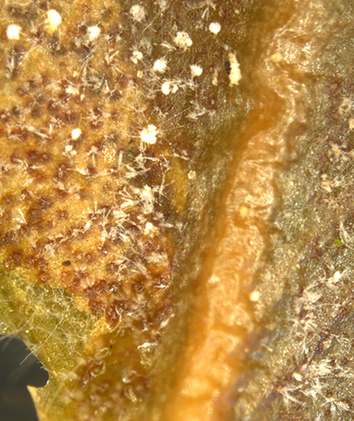
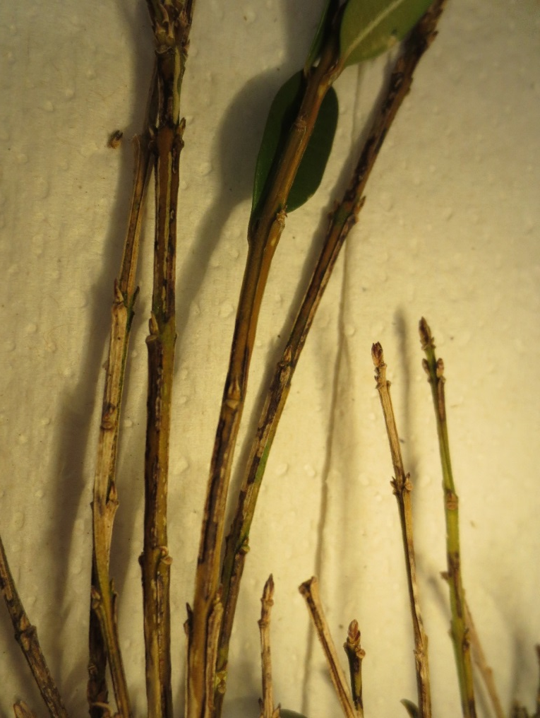
In the laboratory, we look for symptoms and signs of the fungus to confirm an infection.
Notes:
In the laboratory, we look for symptoms and signs of the fungus to confirm an infection.
On the left are bare stems with dark twig lesions, on the right we have zoomed in on a leaf lesion and can just see fungal fruiting structures and spores of the target fungus.
(next slide)

Slide 13
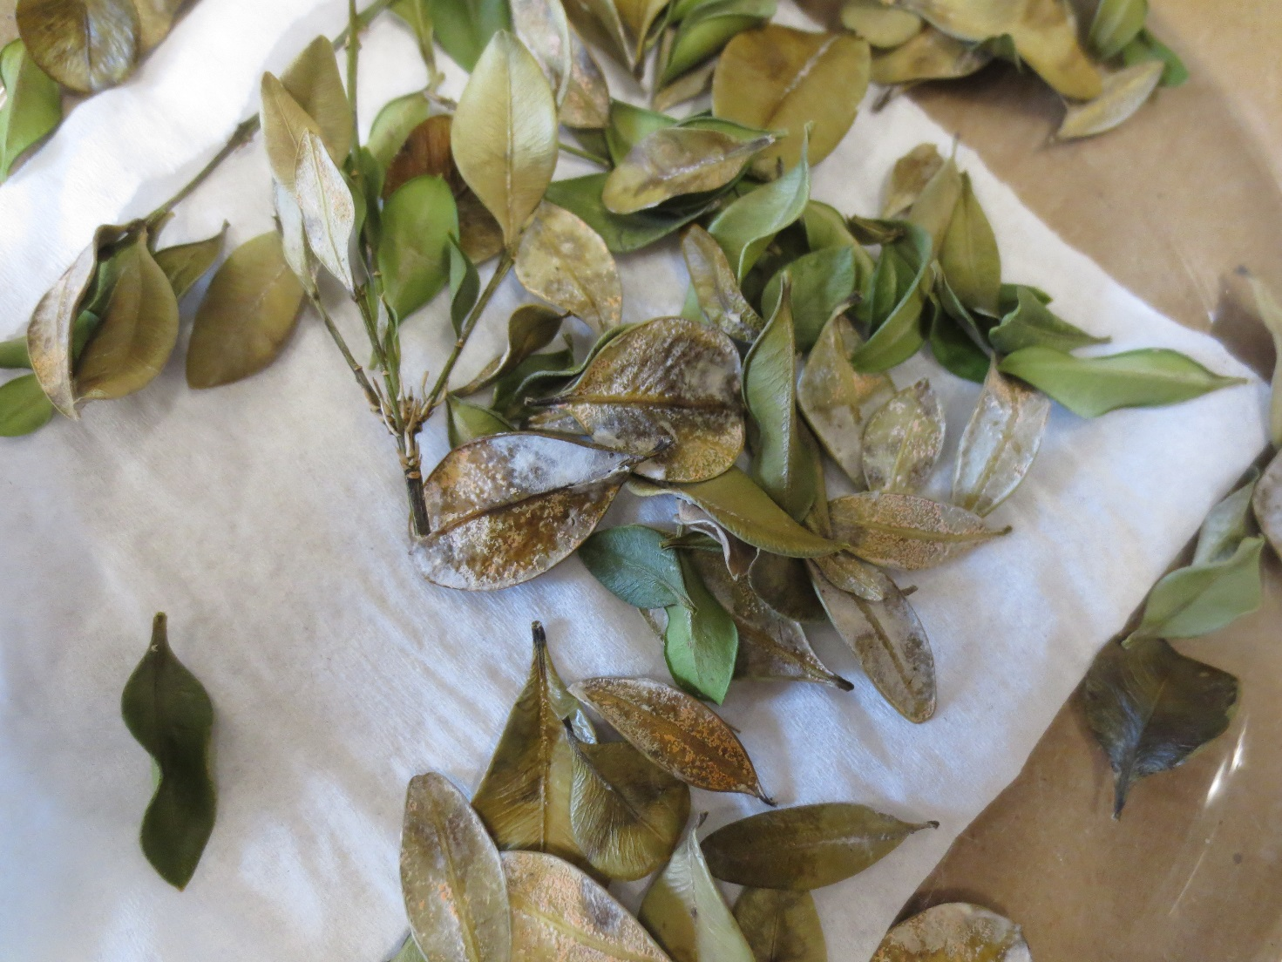
This is not always easy to do
Notes:
This is not always easy to do…samples in poor condition can be covered with other fungi.
(next slide)

Slide 14
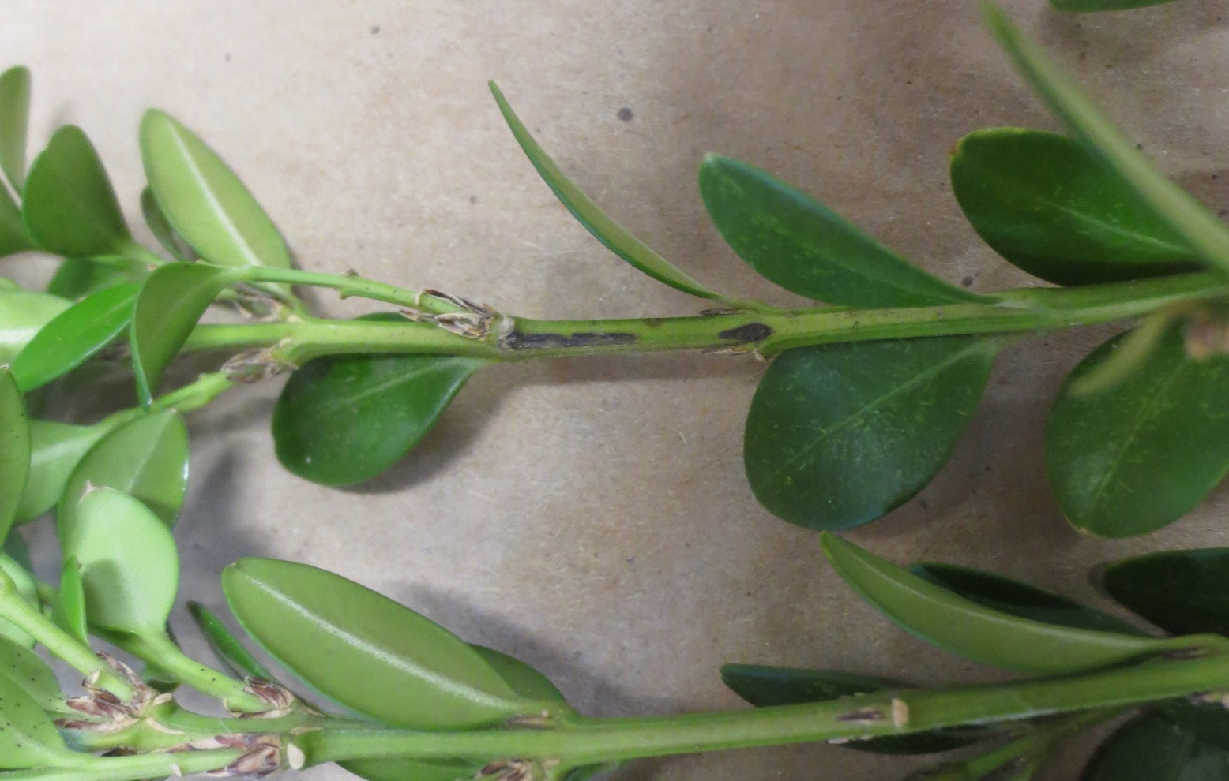
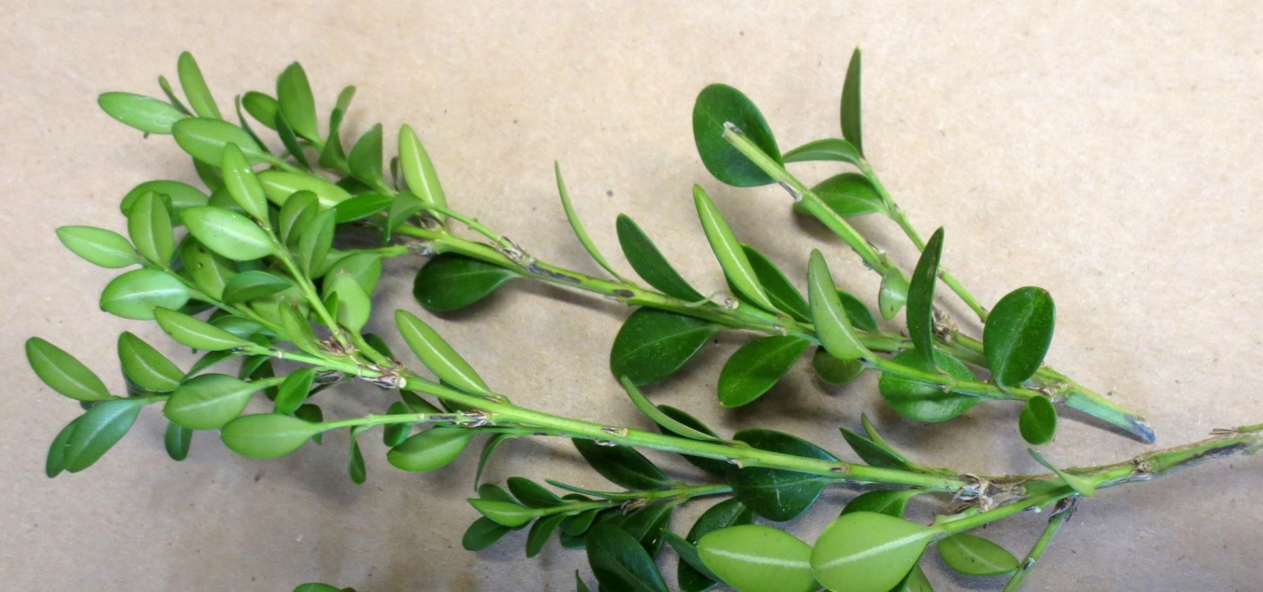
Look for dark twig lesions!
Notes:
This looks like a pretty healthy boxwood branch, doesn’t it?
But is it really?
(advance)
Take a closer look and we find dark lesions on green twigs.
This could be boxwood blight!
(next slide)

Slide 15
Getting Started---Supplies and Equipment
To begin to process a freshly collected suspect boxwood blight sample, you will need the following supplies and equipment:
--A dissecting microscope with a good light source
--A compound microscope
--Microscope slides and cover slips
--A small forceps or tweezers
--Paper towels or “Kimwipes”– we suggest small boxes of “Kimwipes” or similar clean paper products
--A small water bottle—preferably with a spout that allows only drops of water to be dispensed
--“Moist Chambers”---we suggest glass or disposable plastic petri dishes
--Clean-up supplies
Notes:
To begin to process a freshly collected suspect boxwood blight sample, you will need the following supplies and equipment:
--A dissecting microscope with a good light source
--A compound microscope
--Microscope slides and cover slips
--A small forceps or tweezers
--Paper towels or “kimwipes”– we suggest small boxes of “kimwipes” or similar clean paper product
--A small water bottle—preferably with a spout that allows only drops of water to be dispensed
--“Moist Chambers”---we suggest glass or disposable plastic petri dishes
--Clean-up supplies
(next slide)

Slide 16
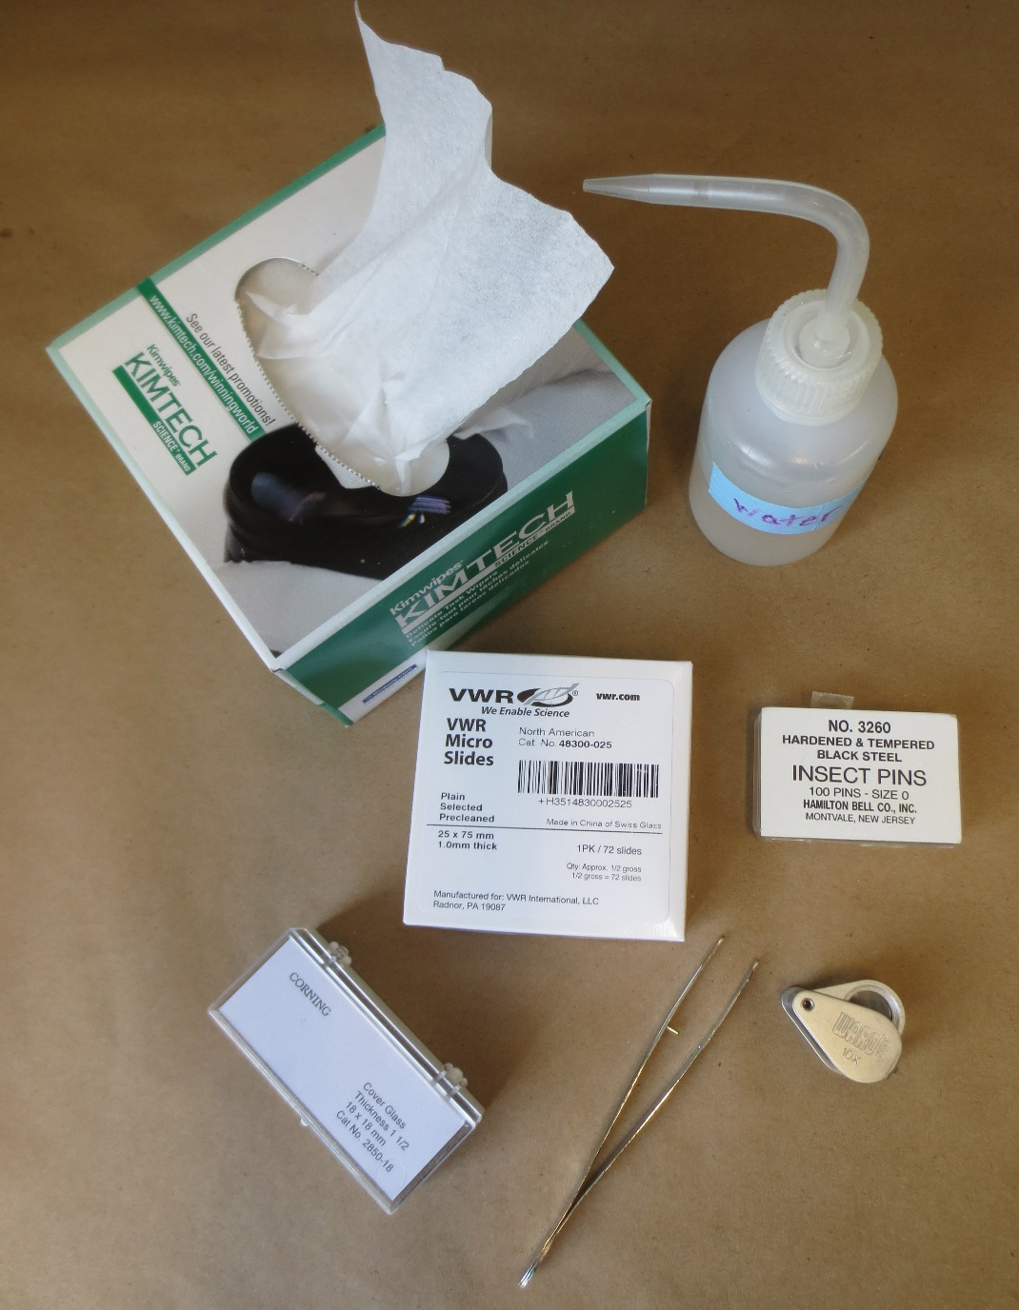
Getting Started
Items needed to handle samples and make slides
Notes:
These are items needed to handle samples and make slides
(next slide)

Slide 17
Examine the Sample:
Briefly look over the sample, checking for evidence of dark leaf spots or twig lesions resembling those shown in the following series of photos
You want to do this because sometimes you will just get lucky…
If the sample was in good shape when collected the fungus just might be sporulating on the sample when you get receive it, and that could save you a lot of time confirming boxwood blight.
Notes:
Examine the Sample:
Briefly look over the sample, checking for evidence of dark leaf spots or twig lesions resembling those shown in the following series of photos
You want to do this because sometimes you will just get lucky…
If the sample was in good shape when collected the fungus just might be sporulating on the sample when you receive it, and that could save you a lot of time confirming boxwood blight.

Slide 18
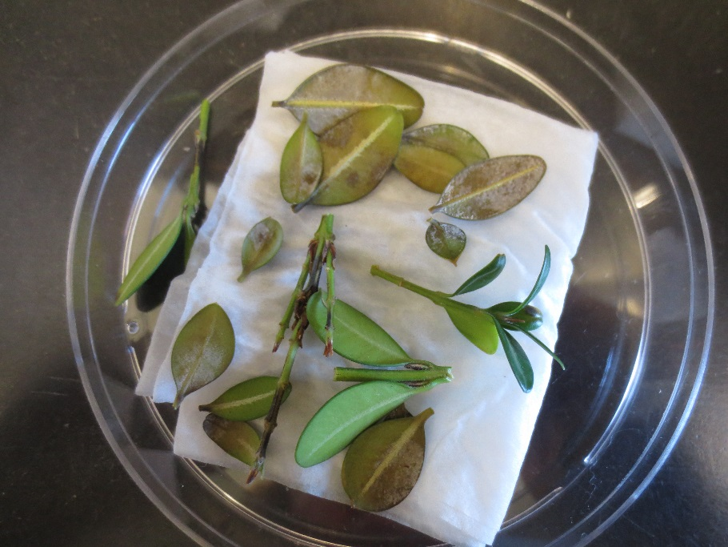
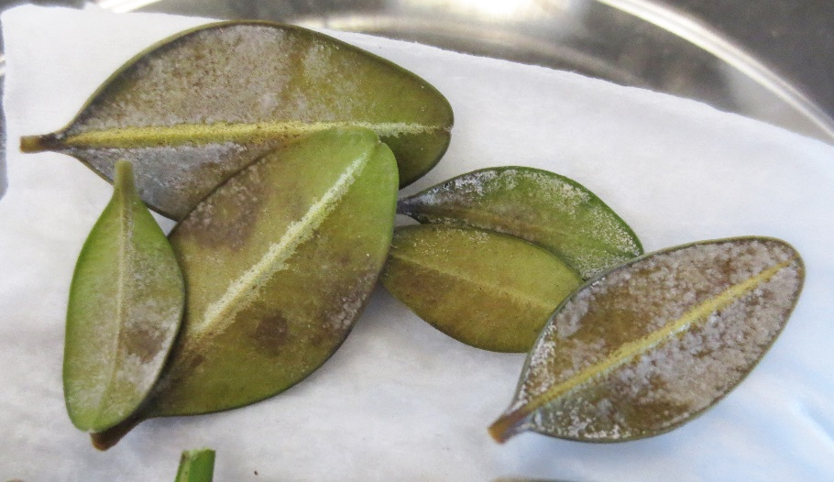
Examine a stem/branch for leaves exhibiting dark spots.
Notes:
Examine a stem/branch for leaves exhibiting dark spots.
With a smaller branch sample, you may be able to examine the entire sample under the dissecting microscope.
With a larger branch sample, you might start by gently shaking loose leaves onto a paper towel and examining those leaves using a dissecting microscope.
(advance)
For either sample size, look for green leaves showing dark lesions; these may be visible on both upper and lower leaf surfaces. Select individual symptomatic leaves, and using forceps or tweezers, grab the leaf at the petiole to remove it without destroying any fruiting structures that may already be present.
Place leaves bottom side up on a paper towel or on a mildly damp kim wipe, tissue, etc. in a shallow moist chamber. Again---use the forceps to handle leaves at this time so that you do not rub the spores off of the surface or contaminate the sample.
(next slide)

Slide 19
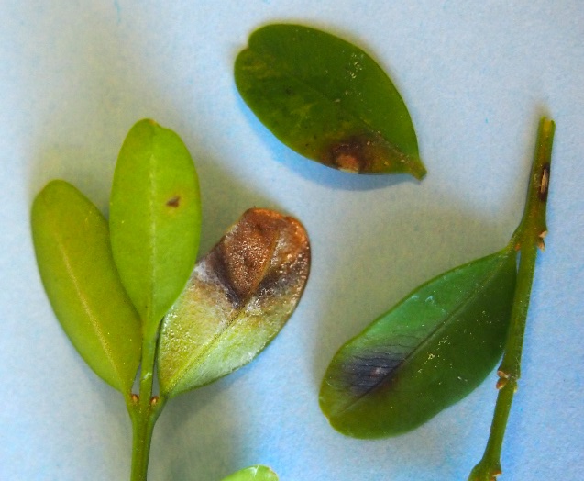
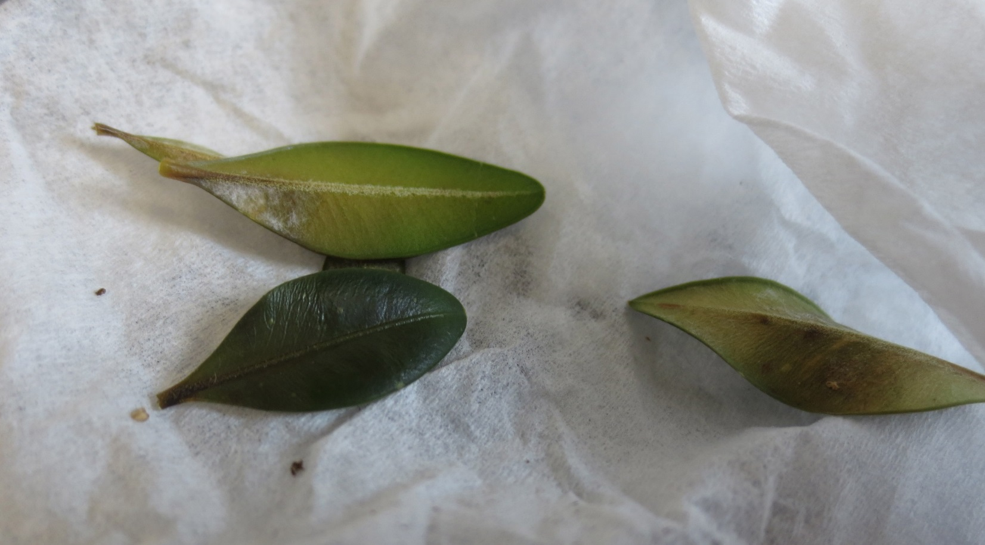
Examine individual leaves…
Notes:
Examine individual leaves more closely…sporulation will usually develop on the underside of the leaf.
(advance)
Light colored mycelium on the undersurface of a dark lesion could be the target fungus
(advance)
Look for thin patches of white mycelium; this should be most evident on the lower surface of leaves, beneath the dark lesions. Dense mycelium may be another fungus or a later stage that no longer contains spores useful for identification
Mycelium will not always be present when you first receive the sample, but leaves showing mycelium may provide sporulation more quickly when incubated than leaves that only exhibit dark spots.
(next slide)

Slide 20
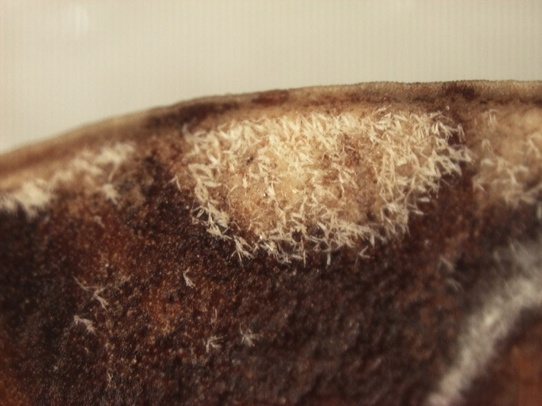
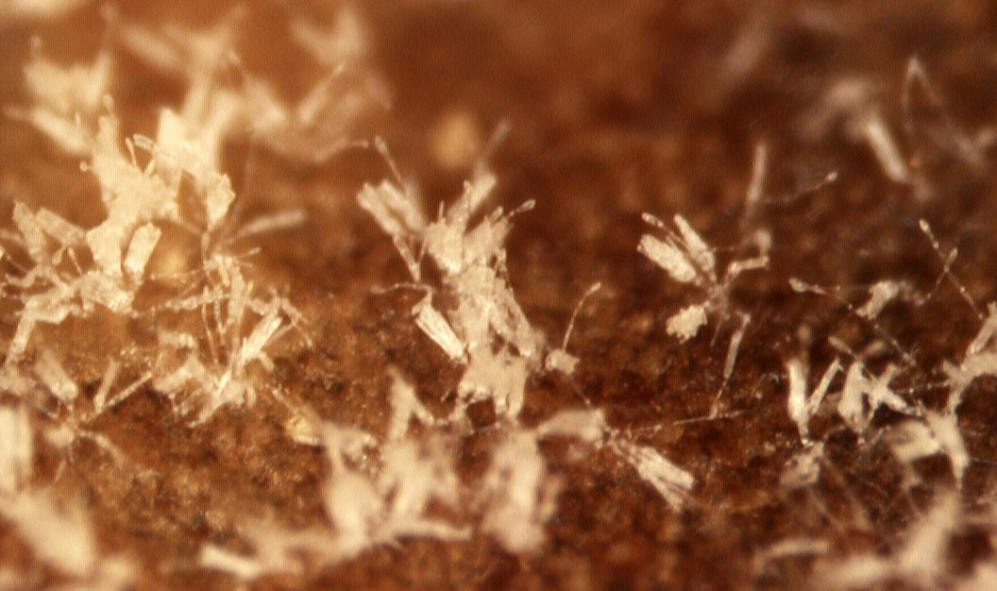
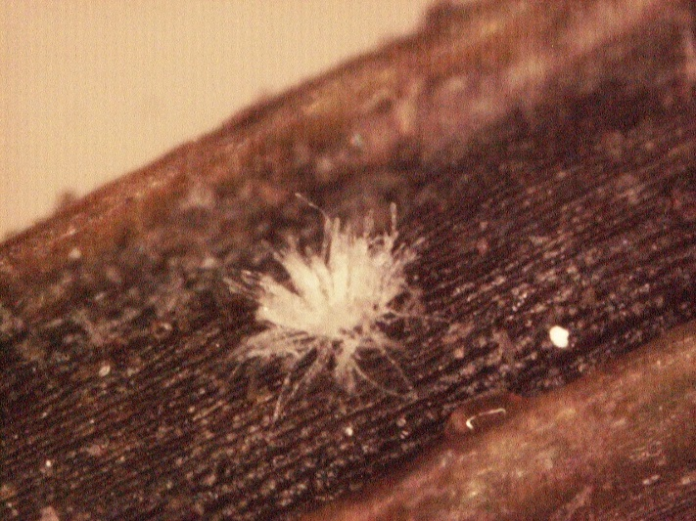
With a good dissecting microscope, you may be able to see the overall fruiting structure of the fungus on the leaf surface.
Notes:
With a good dissecting microscope, you may be able to see the overall fruiting structure of the fungus on the leaf surface.
Including the vesicle (arrow) that stands out above a cluster of spores.
(next slide)

Slide 21
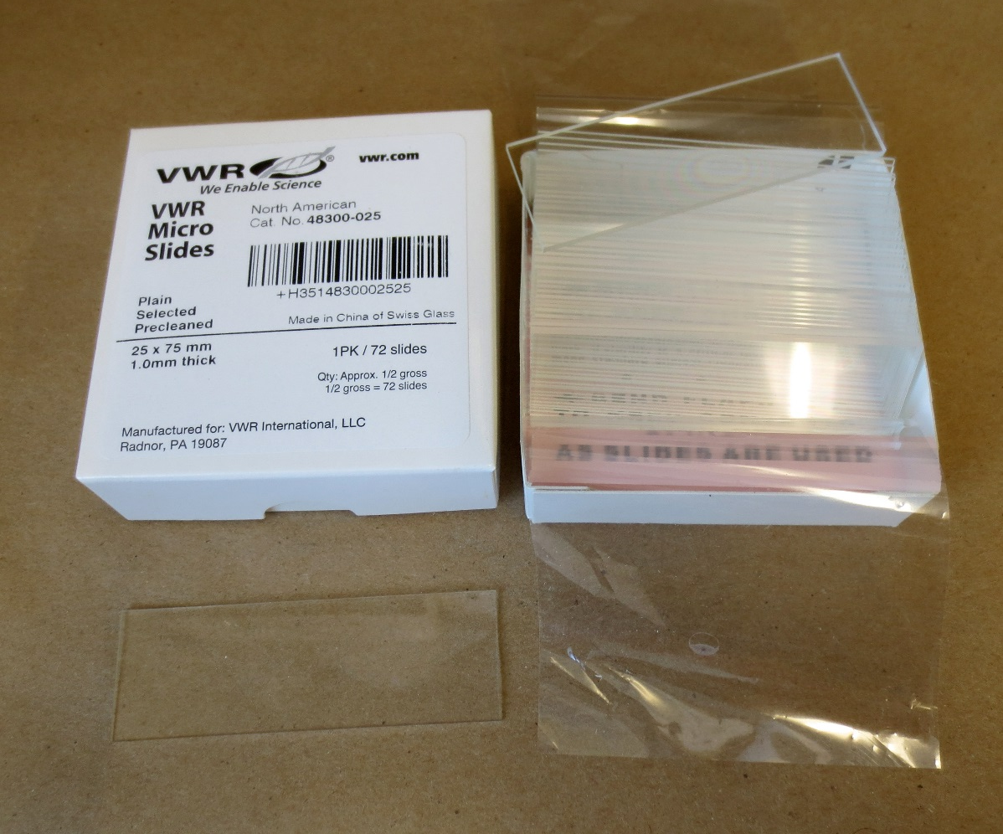
The next step: making a slide
Notes:
The next step is to be certain you can see the appropriate structures to identify the fungus.
Remove a clean slide from the box
(next slide)

Slide 22
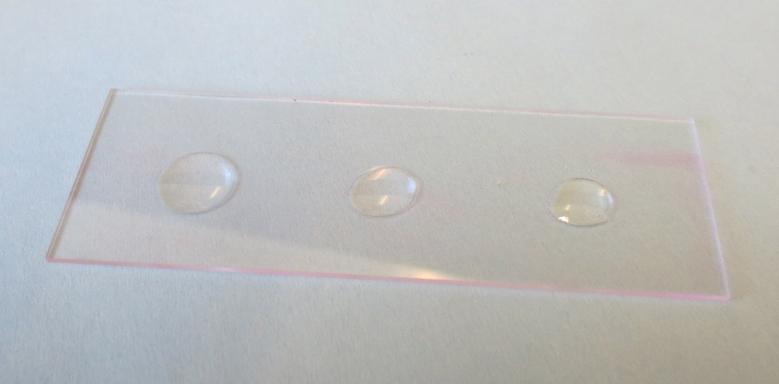
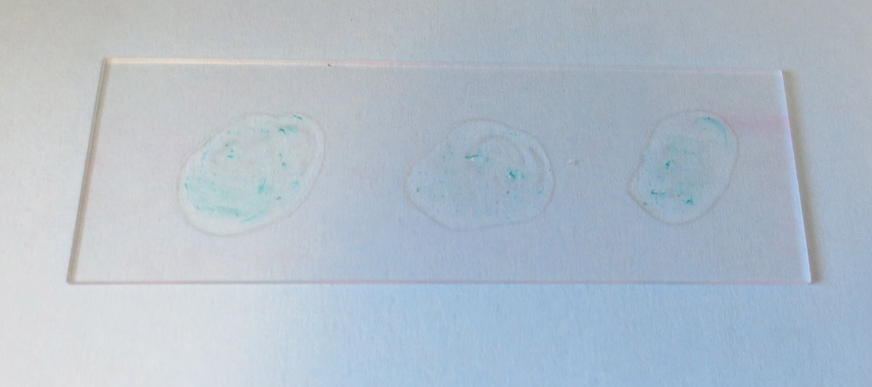
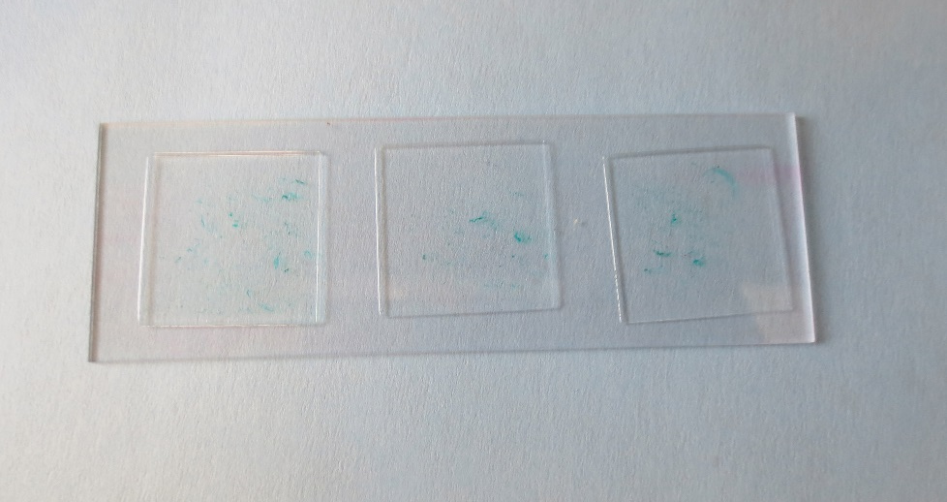
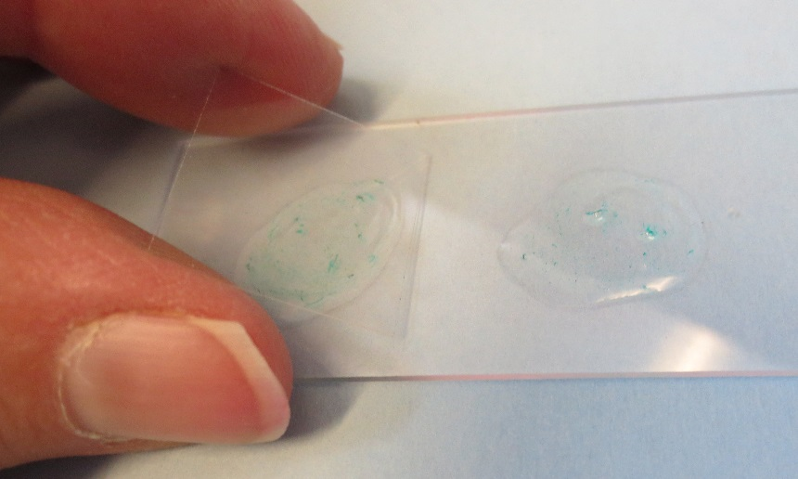
Slide making steps
Notes:
Place a small drop of water on the slide. On a 25 by 75 mm slide, you should have room for three bits of sample tissue and 3 cover slips... The “sample” in this slide is represented by a small amount of green dye—so you can see that you do not want a thick piece of plant tissue on the slide.
(advance)
Scrape a small bit of mycelium from the sample surface using an insect pin or other fine tipped tool such as fine forceps/tweezers.
Place your fungal sample into the water drop
(advance)
Gently place a cover slip over each sample as shown
(next slide)

Slide 23
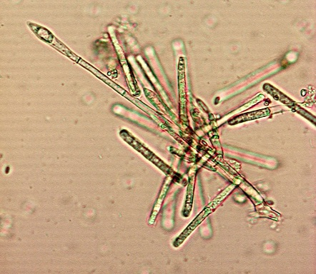
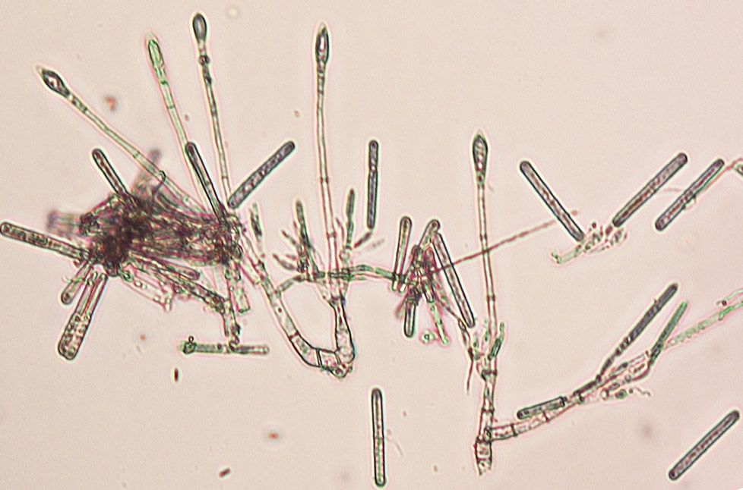
Look for spores and vesicles
Notes:
Examine the slide under the compound microscope for evidence of the pathogen such as elongated two cells conidia or characteristic vesicles as shown earlier in this module….
(next slide)

Slide 24
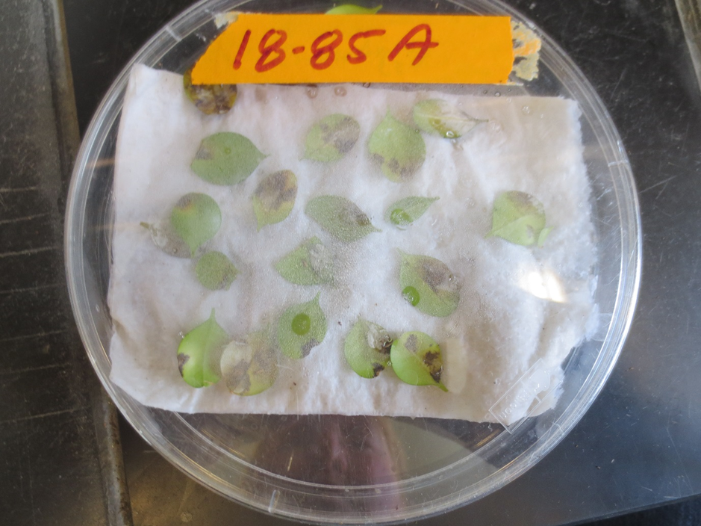
If you cannot confirm the disease from a fresh sample…
…the next step it to set up tissue in a moist chamber
Set up at least one set of sample tissue in a moist chamber 1, 2, or 3 days before you know you will be able to look at it again.
If symptoms are good and you can re-examine the sample over a few consecutive days, a single moist chamber with symptomatic tissue may be adequate.
If you know you can’t get back to the sample for a few days, setting up two or more moist chambers may suffice. If you have adequate tissue set up tissue at different temperatures. This fungus is known to grow on infected tissue at temperatures between about 41º and 86º F., but temperatures in the 70’s may produce the best sporulation.
Notes:
(Information from this slide is provided as a handout for future reference.)
If you cannot confirm the disease from a fresh sample…
…the next step it to set up tissue in a moist chamber
Setting up a moist chamber:
Set up at least one set of sample tissue in a moist chamber 1, 2, or 3 days before you know you will be able to look at it again.
If symptoms are good and you can re-examine the sample over a few consecutive days, a single moist chamber with symptomatic tissue may be adequate
If you know you can’t get back to the sample for a few days, setting up two or more moist chambers may suffice. If you have adequate tissue set up tissue at different temperatures. This fungus is known to grow on infected tissue at temperatures between about 41º and 86º F., but temperatures in the 70’s may produce the best sporulation.
(next slide)

Slide 25
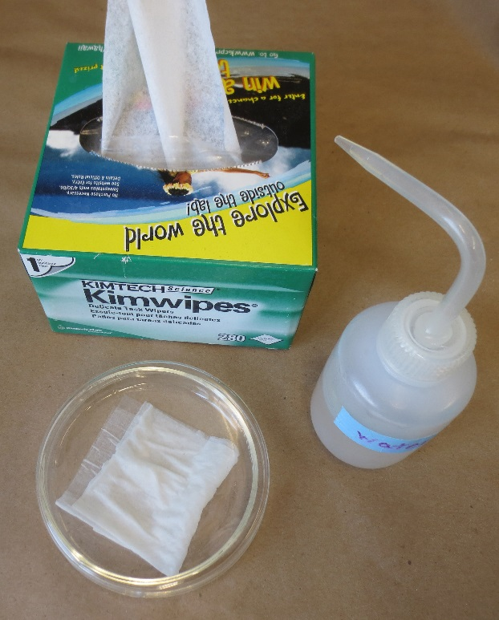
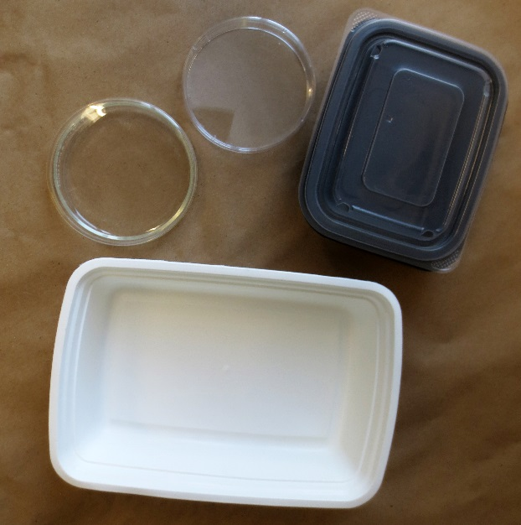
In one or more petri dishes or equivalent container(s), fold, dampen, and place a small “Kimwipe” or paper towel in the bottom of the container.
Using tweezers, pull individual leaves exhibiting any dark discoloration from the branches, and place them bottom side up in the petri dish as shown.
It’s okay if there is some overlap, but avoid just dropping leaves in as a small pile. If small twigs show dark lesions, small twig sections can also be included.
For large samples, use larger containers such as plastic bins with loose lids. Try to avoid using airtight containers for the incubation process.
Notes:
(Information from this slide is provided on a handout for future reference. )
In one or more petri dishes or equivalent container(s), fold, dampen, and place a small “Kimwipe” or paper towel in the bottom of the container.
Using tweezers, pull individual leaves exhibiting any dark discoloration from the branches, and place them bottom side up in the petri dish as shown.
It’s okay if there is some overlap, but avoid just dropping leaves in as a small pile. If small twigs show dark lesions, small twig sections can also be included.
For large samples, use larger containers such as plastic bins.

Slide 26
Petri dish moist chamber
Notes:
Here is an example of a finished moist chamber for incubation of boxwood leaves that show symptoms that may be due to infection by the boxwood blight pathogen.
A bonus when using a small container such as a petri dish is that is can be readily examined under a dissecting microscope without additional or excessive handling that may disrupt sporulation of the fungus.

Slide 27
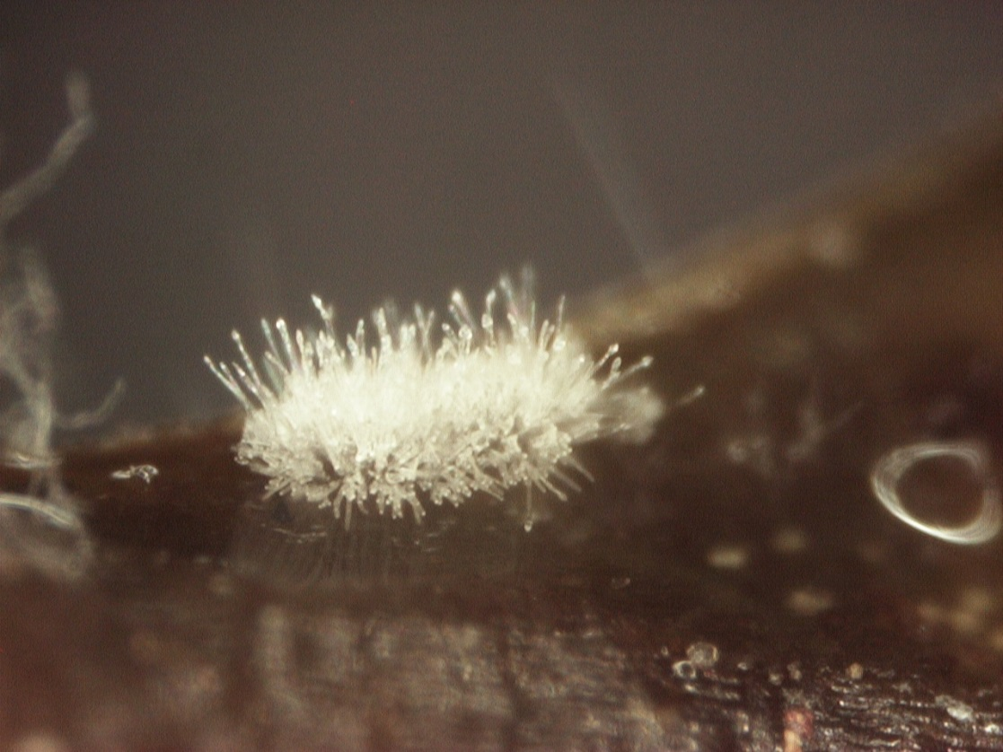
After incubation, re-examine tissue under the dissecting microscope.
Look for characteristic conidiophores with spores and vesicles.
Notes:
Examine tissue under the dissecting microscope.
Look for characteristic conidiophores with spores and vesicles.
(advance)
Closer view
(advance)
Closer view
(next slide)

Slide 28
Scrape off a small sample from any area that resembles any of these photos
…and gently place that sample into the water droplet on your slide.
Notes:
Scrape off a small sample from any area that resembles any of these photos
(advance)
and gently place that sample into the water droplet on your slide.
(next slide)

Slide 29
Look for :
Conidiophores (the entire fungal fruiting structure)
Elongate hyaline conidia (spores)
Vesicles characteristic of Cylindrocladium pseudonaviculatum have an almost diamond shape
Other Cylindrocladium species known in the U.S. may have similar spores, but they will have a vesicle of a different shape
This vesicle is a key feature of this fungus.
vesicle
Long thin spores
Notes:
Look for: Conidiophores (the entire fungal fruiting structure)
Elongate hyaline conidia (spores)
Vesicles characteristic of Cylindrocladium pseudonaviculatum have an almost diamond shape
(advance)
Other Cylindrocladium species known in the U.S. may have similar spores, but they will have a vesicle of a different shape
This vesicle is a key feature of this fungus.
(next slide)

Slide 30
If you do not find characteristic evidence of the boxwood blight fungus, the following slides show other issues that may be mistaken for boxwood blight
When you are only looking at general symptoms
When one or more characteristic symptoms is lacking
When disease symptoms are new to you and you are not yet really familiar with this disease
We will call these other issues:
“Mistaken Identities”
Notes:
If you do not find characteristic evidence of the boxwood blight fungus, the following slides show other issues that may be mistaken for boxwood blight
When you are only looking at general symptoms
When one or more characteristic symptoms is lacking
When disease symptoms are new to you and you are not yet really familiar with this disease
We will call these other issues: “Mistaken Identities”
(next slide)

Slide 31
Mistaken Identities:
Other issues that may be confused with Boxwood Blight include:
-Phytophthora root/crown rot
-Colletrotrichum dieback
-Volutella blight, canker or dieback
-Boxwood leafminer (failed mines)
-Fusarium spp.
Notes:
When trying to determine if a boxwood is infected with the boxwood blight fungus, the following issues may occasionally be mistaken for that disease
(Mistaken Identities:)
Other issues that may be confused with Boxwood Blight include:
-Phytophthora root/crown rot
-Colletrotrichum dieback
-Volutella blight, canker or dieback
-Boxwood leafminer (failed mines)
-Fusarium spp.
(next slide)

Slide 32
Mistaken Identities:
Phytophthora root/crown rot
-Look for general decline of an entire plant or of individual stems
-Some tissue may appear darkened, but distinctive dark foliar or twig lesions are not observed.
Notes:
Mistaken Identities:
Phytophthora root/crown rot
-Look for general decline of an entire plant or of individual stems
-Some tissue may appear darkened, but distinctive dark foliar or twig lesions are not observed.
Note: This is not a photo of Phytophthora, but it does demonstrate decline of a single stem.
(next slide)

Slide 33
Mistaken Identities:
Phytophthora root/crown rot
-If the entire plant is available, check for discoloration beneath the bark of the lower stem and larger roots.
-Wet sites, over-watering, deep planting, or deep mulching may encourage disease.
Notes:
-If the entire plant is available, check for discoloration beneath the bark of the lower stem and larger roots.
-Wet sites, over-watering, deep planting, or deep mulching may encourage disease.
(next slide)

Slide 34
Mistaken Identities:
Colletotrichum dieback
This may initially appear similar to Phytophthora as a general decline of the entire plant or individual stems
Some tissue may appear darkened, but distinctive dark foliar leaf spots are not observed.
Twigs may die back to a dark “zone” or lesions may appear diffuse on twigs, but the dark stems tissue and leaf loss can be mistaken for boxwood blight
This issue typically develops on plants suffering severe moisture stress.
Notes:
Mistaken Identities:
Colletotrichum dieback
Similar to Phytophthora as general decline of entire plant or individual stems may occur
Some tissue may appear darkened, but distinctive dark foliar leaf spots are not observed.
Twigs may die back to a dark “zone” or lesions may appear diffuse on twigs, but the dark stems tissue and leaf loss can be mistaken for boxwood blight
This issue typically develops on plants suffering severe moisture stress.
(next slide)

Slide 35
Mistaken Identities:
Volutella blight, canker or dieback
Off color foliage, tan dry leaf tissue develops.
General decline of leaves, twig tips, entire stems.
White fungal growth may initially be apparent on leaves or twigs
Fungal growth eventually develops a salmon pink color.
Issue typically develops on plants stressed or damaged by other pests or abiotic injury such as drought, winter desiccation, rodent chewing damage to lower stems, etc.
Notes:
(Mistaken Identities:)
Volutella blight, canker or dieback
Off color foliage, tan dry leaf tissue develops.
General decline of leaves, twig tips, entire stems.
White fungal growth may initially be apparent on leaves or twigs
Fungal growth eventually develops a salmon pink color.
Issue typically develops on plants stressed or damaged by other pests or abiotic injury such as drought, winter desiccation, rodent chewing damage to lower stems, etc.

Slide 36
Volutella sporodochia
Volutella pointed setae
Boxwood blight long thin spores
Vesicle
Volutella spores
Notes:
Squash a pinkish pustule of Volutella on a slide and you can clearly see the setae with pointed tips, no vesicle as in photo on lower left side!
Setae are nearly clear, unlike the dark seta of Colletotrichum, and spores are very small.
(next slide)

Slide 37
Mistaken Identities:
Boxwood leafminer (failed mines)
Mines that fail can darken as secondary organisms colonize the dead larvae.
As leaf tissue around the mine dies it may be mistaken for foliar lesions.
Damaged tissue may be readily invaded by fungi.
Incubate to be certain as lesions that appear to be caused by the leafminer, may have also been colonized by C. Pseudonaviculata.
Notes:
Mistaken Identities:
Boxwood leafminer (failed mines)
Mines that fail can darken as secondary organisms colonize the dead larvae
As leaf tissue around the mine dies it may be mistaken for foliar lesions
Damaged tissue may be readily invaded by fungi
Incubate to be certain as lesions that appear to be caused by the leafminer, may have also been colonized by C. pseudonaviculata
(next slide)

Slide 38
Mistaken Identities:
Fusarium spp.
White fungal growth may initially be apparent on declining leaves or twigs.
Microconidia of the fungus may develop in clumps from conidiophores on the tissue.
Fusarium spp. may invade boxwood in manner similar to Volutella. i.e. colonizing tissue stressed or killed by other issues.
Small single cell spores shown on the right may be Fusarium micro-conidia or conidia of a Volutella buxi ; both commonly grow on the same samples.
Notes:
Mistaken Identities:
Fusarium spp.
White fungal growth may initially be apparent on declining leaves or twigs.
Microconidia of the fungus may develop in clumps from conidiophores on the tissue.
Fusarium spp. may invade boxwood in manner similar to Volutella. i.e. colonizing tissue stressed or killed by other issues.
Small single cell spores shown on the right may be Fusarium micro-conidia or conidia of a Volutella buxi ; both commonly grow on the same samples.
(next slide)

Slide 39
Mistaken Identities:
Fusarium spp.
Macro-conidia of the fungus may be elongated, multi-celled, and curved, often described as being canoe-shaped.
One terminal cell may also be attenuated or “foot-shaped” as shown on the right.
Notes:
Mistaken Identities:
Fusarium spp.
Macro-conidia of the fungus may be elongated, multi-celled, and curved, often described as being canoe-shaped.
One terminal cell may also be attenuated or “foot-shaped” as shown on the right.
(next slide)

Slide 40
Mistaken Identities: Can you see three fungi?
2
1
3
1. Volutella 2. Fusarium 3. Cylindrocladium
Notes:
Can you see three fungi?
(advance )
1. Volutella
(advance)
2. Fusarium
(advance)
3. Cylindrocladium
(next slide)

Slide 41
Macrophoma (Dothoriella)
Notes:
A few more issues---but less often mistaken…
With dark round fruiting bodies of the fungus Dothiorella erupting from the surfaces of the leaves, Macrophoma leaf blight is usually easy to differentiate from other fungi that colonize boxwood. Keep in mind however that the presence of this fungus does not negate the presence of the other. If leaves with these characteristic pycnidia are shed, infected twig tissue with dark areas may remain. Loss of leaves and dark lesions on twigs are a combination of symptoms that could be mistaken for boxwood blight.
(next slide)

Slide 42
Boxwood Leafminer
Notes:
Boxwood Leafminer
Looking at these three photos, you might think…well that is boxwood leafminer on the left and boxwood blight on the right, and you would be correct….but what is wrong with that leaf in the center?
In the photo on the far right, leaves that appeared to have been damaged by leafminer ALSO developed boxwood blight.
If in doubt, incubate and re-check!
(next slide)

Slide 43
Boxwood mite
Notes:
Boxwood mite
Extensive scratch-like damage to boxwood is caused by the boxwood mite. Although you may already be familiar with this, keep in mind that if this injury were just a little more severe, and these leaves were a little more yellow, a homeowner not familiar with common boxwood issues may become concerned. (next slide)

Slide 44
What is this?
Notes:
What is this?
These were recently planted boxwood that showed these symptoms the following spring.
Plant history, site and cultural care are important too.
(next slide)

Slide 45
Winter injury!
Notes:
Taking a closer look, we see variation in the level of tissue damage to each plant.
(advance)
Then by focusing in on the individual damaged stems, we see that the bark has peeled away from the woody tissue below the point of injury. The woody tissue that is exposed appears a uniform tan color, and there is no dark discoloration to suggest Phytophthora root/collar rot… So what could this be?
(advance)
If you know…new planting, deep mulch, frequent irrigation…..overall stress leaving to an increased likelihood of…
(advance)
Winter injury!
(next slide)

Slide 46
Established
Notes:
This photo shows nearby established plants that did not suffer extensive winter injury.
(next slide)

Slide 47
What do you think about this plant?
Watch out for
mechanical injury!
Notes:
What do you think about this plant? Could this top dieback be due to boxwood blight?
(Advance)
Zoom in and we see some odd looking symptoms.
(Advance)
Zoom again, and we find that the plant suffered mechanical injury. On branch was entirely broken off. Not only may the surrounding branches have suffered from cracking, but that surrounding foliage would have been newly exposed to sunscald and winter drying
(next slide)

Slide 48
When symptoms suggest boxwood blight but you just can’t find the spores…why ask for a better sample?
If the sample was mailed, it may have been overheated or frozen in transit.
High heat especially may kill your target organism preventing it from developing on even the most characteristically symptomatic tissue.
If the sample was collected but held for several days before submission…the sample could dry out excessively and/or spores present may germinate resulting in dense white mycelium but no spores!
If the plant was treated with a fungicide prior to collection, that can interfere with timely development of conidiophores and conidia on the tissue
If the sample was packaged with very wet paper towels…that can cause extensive breakdown and premature decay of the plant tissue. Volutella, Fusarium etc. may eventually grow out of such tissue, but C.p. sporulates best on tissue that has not been dead for days, weeks, or months…
Notes:
When symptoms suggest boxwood blight but you just can’t find the spores…why ask for a better sample?
If the sample was mailed, it may have been overheated or frozen in transit.
High heat especially may kill your target organism preventing it from developing on even the most characteristically symptomatic tissue.
If the sample was collected but held for several days before submission…the sample could dry out excessively and/or spores present may germinate resulting in dense white mycelium but no spores!
If the plant was treated with a fungicide prior to collection, that can interfere with timely development of conidiophores and conidia on the tissue
If the sample was packaged with very wet paper towels…that can cause extensive breakdown and premature decay of the plant tissue. Volutella, Fusarium etc. may eventually grow out of such tissue, but C.p. sporulates best on tissue that has not been dead for days, weeks, or months.

Slide 49
Colletotrichum
Notes:
Or it could have ….the dreaded Colletotrichum
This is the worst ---the hardest to differentiate if you only have twig lesions to look at.
If there are no foliar lesions, and you cannot find sporulation on the dead or dying twigs that have dark lesions…
Send this to the Clinic…or ask for another sample.
If all you have is dark lesions on the twigs, infections caused by Cylindrocladium or Colletotrichum are very difficult to tell apart!
(next slide)

Slide 50
BOXWOOD BLIGHT SUSCEPTIBILITY TRIAL M. GANCI, D.M. BENSON AND K. IVORS, NC STATE
HIGHLY SUSCEPTIBLE |  | MODERATELY TOLERANT
 | B. sempervirens ‘Suffruticosa’ |  | B. microphylla ‘John Baldwin’
 | B. sinica var Insularis ‘Justin Brouwer’ |  | Buxus ‘Green Gem’
QUITE SUSCEPTIBLE |  |  | B. sempervirens ‘Fastigiata’
 | B. sempervirens Elegantissima — |  | B. sempervirens ‘Dee Runk’
 | B. sempervirens “American” |  | B. microphylla ‘Winter Gem’
 | Buxus X ‘Glencoe’ Chicagoland Green | TOLERANT
 | B. sempervirens ‘Marginata’ |  | B. microphylla ‘Golden Dream’
 | B. sempervirens ‘Jensen’ |  | B. harlandii
 | B. microphylla var. japonica ‘Morris Midget’ |  | B. sinica var. insularis ‘Nana’
 | B. microphylla var. japonica ‘Morris Dwarf’ |  | B. microphylla var. japonica ‘Green Beauty’
MODERATELY SUSCEPTIBLE |  | OTHER KNOWN HOSTS
 | Buxus X ‘Green Mound’ |  | Pachysandra procumbens= Allegheny-spurge
 | Buxus X ‘Conroe’ (Gordo) |  | P. terminalis = Japanese spurge
 | B. microphylla ‘Green Pillow’ |  | Sarcococca spp. =sweet box
 | B. microphylla ‘Grace Hendrick Philllips’
 | B. microphylla ‘Jim Stauffer’
 | Buxus X ‘Green Mountain’
Notes:
For information on susceptibility of species and varieties, we borrowed this information for reference.

Slide 51
From CABI: Invasive Species Compendium
https://www.cabi.org/isc/datasheet/17414
Preferred Scientific Name: Calonectria pseudonaviculata (Crous, J.Z. Groenew. & C.F. Hill) L. Lombard, M.J. Wingf. & Crous, 2010
Preferred Common Name: Buxus blight
Other Scientific Names: Cylindrocladium buxicola Henricot 2002 and
Cylindrocladium pseudonaviculatum Crous, J.Z. Groenew. & C.F. Hill, 2002
International Common Names (English): box blight; boxwood blight; boxwood leaf drop; leaf and twig blight of box
EPPO code: CYLDBU (Cylindrocladium buxicola)
Notes:
This is a great site to check if you want an exact description of the sporulating fungus!

Slide 52
Thank you!
This presentation was made possible through the financial support of a New York State Community IPM Grant
Primary Author: Sandra Jensen
Project contributor: Karen Snover-Clift

